Slide 1
15th July Presentation

Slide 2
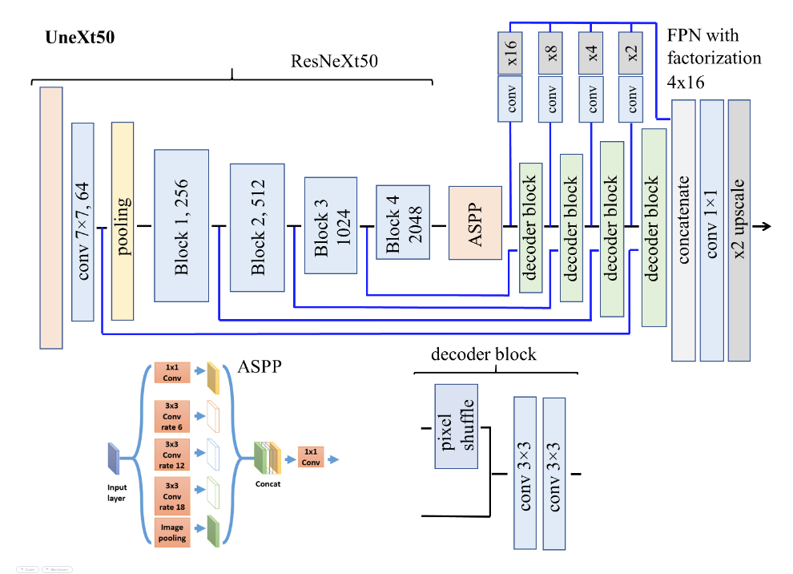
Short review of the previous work
Previously my excellent teammate has achieved quite a high mark in the competition through UNeXt model.
The model is composed of the backbone part (ResNeXt50), ASPP block, decoder part.

Slide 3
Preface
The backbone of the model determines the performance more than any other part, so it seems to be a good idea to work on improving the backbone part
Another idea to elevate the performance of the model is to improve the data augmentation part

Slide 4
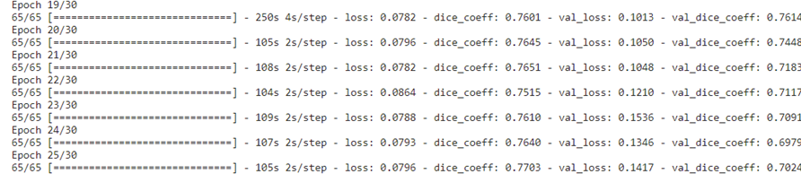
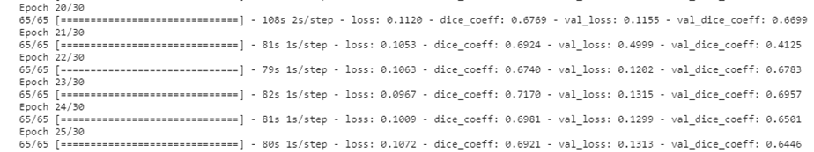
SE-ResNet
SE-ResNet is an improved model of traditional ResNet.
Before we concatenate the SE-ResNet with other parts of the model, we did a test and found that SE-ResNet based U-net performs much better than that of the ResNet-based Unet

Slide 5
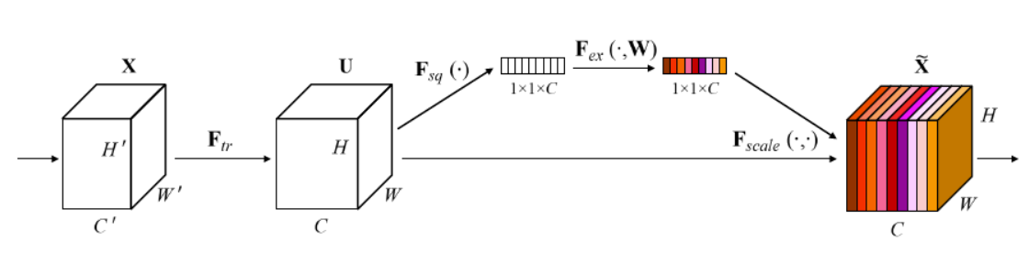
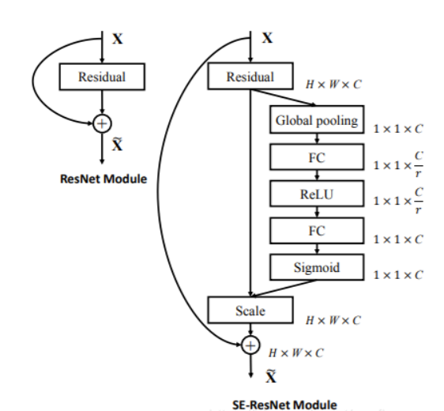
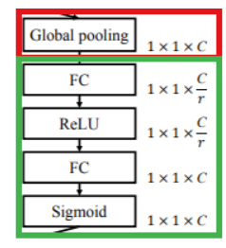
SE-ResNet
1. The meaning of SE: Squeeze-and-Excitation.
2. The excitation part has been demonstrated in the figure in the right-bottom corner (operations in the green block)
3.Squeeze operation: the operation in the red block. The global pooling reduce the size of the input from W*H to 1. It somehow has a global field of perception

Slide 6

SE-ResNeXt
The excitation part: two FC (fully connected layers and two activation functions) (in the green block)

Slide 7
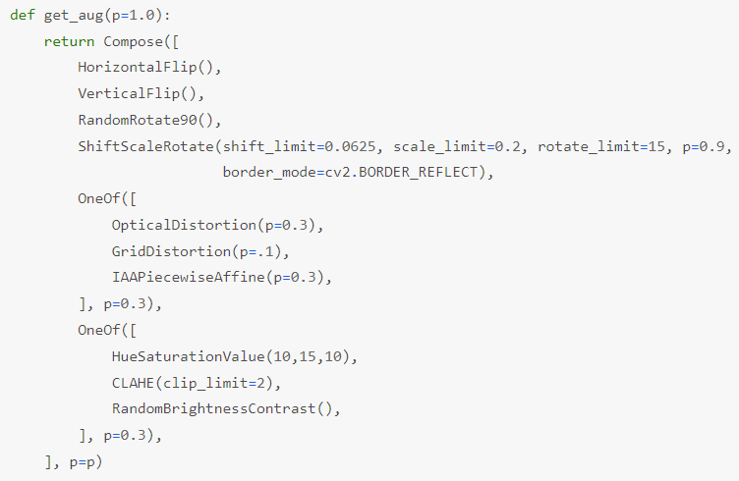
Data Augmentation
The original version of data augmentation:
HorizontalFlip()
VerticalFlip()
RandomRotate90()
ShiftScaleRotate()
Some methods to distortion
Other methods

Slide 8
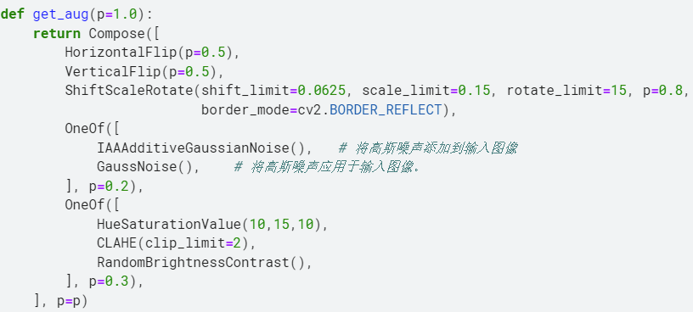
Data Augmentation
The New version of data augmentation:
Substitute the distortion with the Gauss Noise method.
The Gauss method is aimed to solve the problem of overfitting through shadow the features which are too frequent.

Slide 9

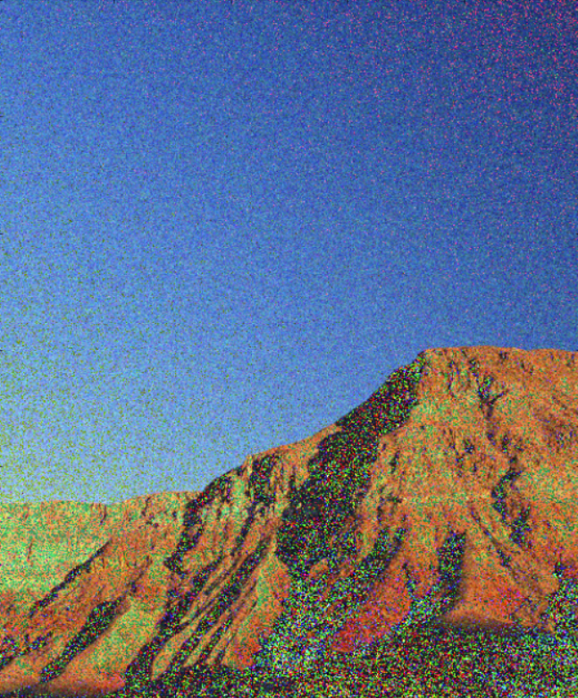
Data augmentation (Gaussian noise)

Slide 10
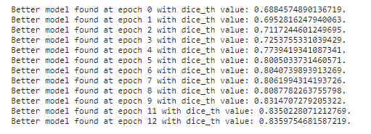
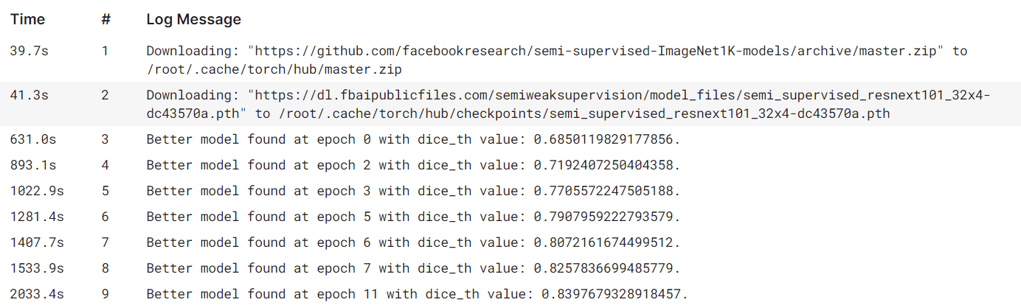
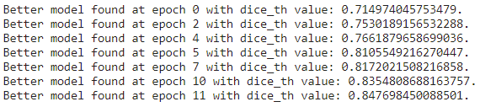
Results and comparisons
The original model: 83.6
The improved version after implementing SE-ResNeXt: 84.0
The improved version with both SE net and new data augmentation strategy: 84.7

Slide 11
Future plan
Making use of conditional random field(CRF) to make subtle modifications on the segmentation output
Deepening the backbone model (from SE-ResNet50 to SE-ResNet101)
Try to continue to improve the data augmentation.
Try some new complex models

Slide 12
Thank you!

